Slide 1

Coders Assembly
Code Clinic

Slide 2
Today’s Content
1300 - 1330: Key Concepts / Common Mistakes
1330 - (1515 or 1530): HANDS- ON CODING!!!!
(1515 or 1530) - 1555: Go through certain questions.
1555 - 1600: Final tips for Lab Test 1
GO FOR YOUR BREAK WEEK!
<br>

Slide 3
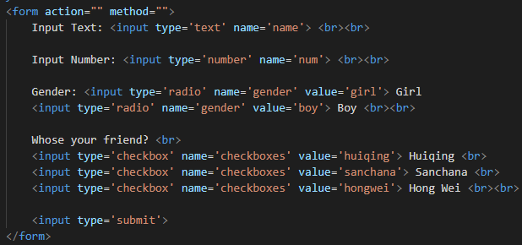
Creating HTML Forms
Notes:
Go demonstrate on Visual Studio Code
Method and Action
Self-calling PHP

Slide 4
Form Processing

Slide 5
Coding Tips
Copy and paste where you can.
var_dump to check for errors
Test your code EVERYTIME

Slide 6
Hands-On Coding Starts NOW!
Questions: https://docs.google.com/document/d/1mBH2lU3ketqz1wzTrg4TlkWP1yvpCe1IyBobbYXCxxI/edit?usp=sharing
Progress Check @ 1530

Slide 7
Final Tips
If you’re stuck, move on to the next part / question
var_dump() when you get an error message. Then comment it out.
Time yourself for each question.
Don’t panic.

Slide 8
Thank you!
And all the best for your Lab Test. Go $_GET that A- .

